Slide 1
Python Artificial Intelligence Projects for Beginners Chapter 5: Deep Learning
Team 5 LEFEBVRE Tania LUKAC Yelena MABROUK Jibril MAILLARD Lola MANSOURI Mohamed
Big Data Analytics – for M. Khalfallah – at Université Paris Est Créteil, AEI International School

Slide 2
INTRODUCTION
Deep learning is part of machine learning that uses deep artificial neural networks to solve complex problems. Deep neural networks are multi-layered neural networks that learn hierarchical representations of the input data. Thus, deep learning allows the solving of difficult problems that cannot be solved with traditional machine learning methods.
The CNN (Convolutional Neural Network) is a type of deep neural network specifically designed for computer vision. CNNs are based on the application of convolution filters to extract meaningful features from images. The features are then transformed by traditional neural network layers to perform tasks such as classification, object detection, etc.
Python is a popular programming language for machine learning and deep learning.
Convolutional neural networks (CNNs) have been widely used for various computer vision tasks, including image classification and object detection.

Slide 3
USE CASE PRESENTATION & PROBLEM DEFINITION
Our case study is about CNN and how the computer can recognize images.
Case study 1 :
In the first case, the goal is for the computer to be able to recognize handwritten mathematical symbols. For this, an algorithm is programmed through training, testing and hyper parameterization phases. It is trained by showing it a variety of pictures of handwritten mathematical symbols, in different scripts, from different angles. The algorithm must learn to understand the different features through the pixels of the photo and evaluate the accuracy of the recognition. To achieve this goal, a convolutional neural network (CNN) is used.
Case study 2 :
The second case study aims to teach a neural network to recognise types of birds through image recognition. We provide it with a knowledge base via images so that the AI learns to recognise in our example what a bird is in order to be able to sort birds by different categories and even generate new birds.

Slide 4
USE CASE PRESENTATION & PROBLEM DEFINITION – Case 1
Problem definition for case study 1
Problems were highlighted at each step of the program development, but the main one was to understand how the machine can recognize handwritten mathematical symbols using CNN in Python. And also, how can the model be accurate when there is a large variability in handwriting styles, mathematical symbols are quite often complex.
At each step of the programming, problems were present around:
Database
Building CNN Model
Training the model
Testing the model
In the first place to address this problem, we need the database of the handwritten mathematical symbols (HASYv2). It was be used to train and test the CNN model. It is important that the databases include a wide variety of data for the model to generalize and learn. Other libraries were also necessary to make the code work such as keras, TensorFlow, Pillow and Scikit-learn.
The difficulty in getting the computer to understand handwriting is that there are as many styles of writing as there are people writing. In other words, the dataset is surely inconsistent and lacks regularity. To solve this problem, the data must be pre-processed by normalizing it, filtering it and sometimes hiding some of it.

Slide 5
USE CASE PRESENTATION & PROBLEM DEFINITION – Case 2
To achieve this, in this part we have the typical import of different tools for the program (keras allows to experiment with deep neural networks, tensorflow allows to learn from machines and to develop AI, numpy allows to manipulate matrices or multidimensional arrays, intertools is a module that implements many object bricks representing an iterative data flow...)
We create convenience variables, the rows and columns of the image, the width and height and the number of channels, RGB which defines the primary colours.
We use an interesting feature on Keras called ImageDataGenerator it allows to produce new images from the existing set of images and these new images can have various differences; for example, they can be rotated, they can be flipped horizontally or vertically.
A reset is made so that all the same images are produced in the same order. We have 4 different folders and within these folders are the particular bird images. We want all the images to be resized to 256 x 256 , we use categorical classes, which means we will have many different classes (4, in this case).
By using the generator, we don't have any new images prepared in advance, it will produce these images as we go along.

Slide 6
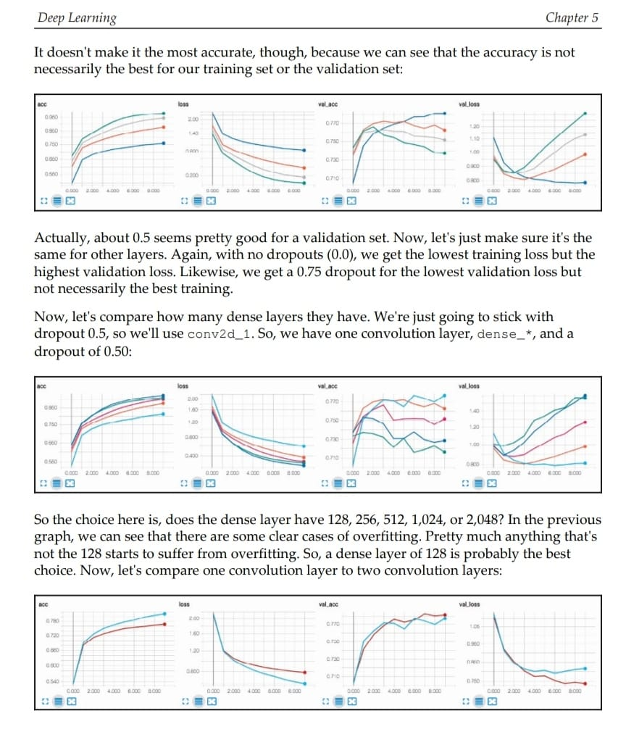
DATA ANALYTICS APPROACH DEFINITION AND EXPLANATION – Case 1
The approach chosen in this code is the data visualization to find the right architecture. It is about identifying patterns and anomalies in the data. The visualization includes histograms, diagrams, curves... By examining them, we can identify the problems of the data and find the most relevant model. This approach allows to facilitate the understanding and to highlight the problems in order to take the relevant decisions later.

Slide 7
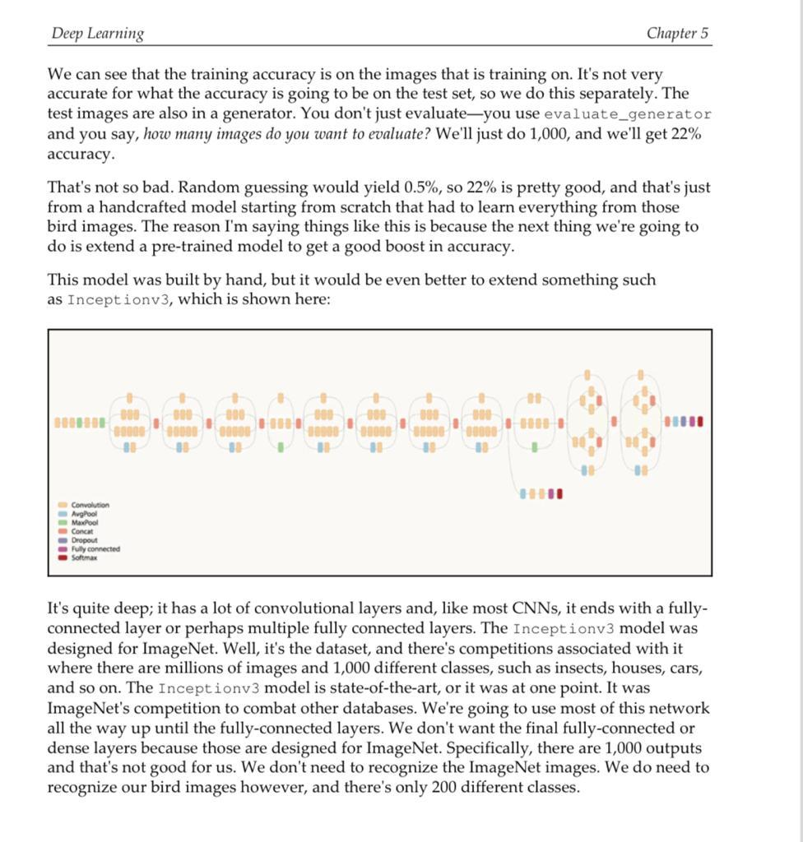
DATA ANALYTICS APPROACH DEFINITION AND EXPLANATION - Case 2
The approach chosen in the second case is data visualization to find the right RGB architecture. This involves identifying bird types across different images. By examining them, we can identify the type of bird and then sort them into categories to find the most relevant images.
This approach makes it easier for the AI to learn bird types more quickly and easily. The more images the neural network visualizes, the easier it will be to recognize the type of bird.

Slide 8
SOLUTION DEVELOPMENT AND ILLUSTRATION – Case 1
For the problem of overfitting: to solve this problem, various techniques can be used such as dropout, data augmentation, reducing the number of model parameters, and selecting less complex models.
For the problem of underfitting: To solve this problem, it is possible to use techniques such as adding layers to the model, increasing the number of neurons in the existing layers, and adjusting the hyperparameters.
The problem of the vanishing gradients: To solve this problem, it is possible to use techniques such as initializing the weights of neurons with appropriate values, the use of non-saturating activation functions, and the use of batch normalization.
Inappropriate choice of network architecture: To solve this problem, you can use techniques such as automated hyperparameter discovery, analysis of model performance with different datasets and architectures, and use of predefined models - trained for similar tasks.
Data augmentation: To solve this problem, you can use techniques such as rotating, scaling, shifting, changing brightness, and cropping images to create additional data.

Slide 9
SOLUTION DEVELOPMENT AND ILLUSTRATION - Case 2
To solve this problem, we can use image generation techniques such as GANs (Generative Adversarial Networks). GANs are a type of neural network that can learn to generate new images by comparing them to real images and adjusting their weights to approximate the probability distribution of real images.
We will also use programming libraries such as TensorFlow to create our own dataset by extracting images from an online source.
Once we have our own dataset, we can train our neural network (GAN) using libraries such as TensorFlow. The GAN will learn to generate bird images using a generator-discriminator architecture that is trained to generate images indistinguishable from real images.
After training, the artificial intelligence will be able to generate new bird images by entering a specific bird category into the model. The model will then generate a new bird image of that category.

Slide 10
EVALUATION AND FEEDBACK
While working on this code, we realized that :
After a while, the accuracy does not increase anymore despite the changes made. This can be due to the low complexity of the architecture.
Jupyter is not that intuitive (example: kaggle more intuitive for instance)
It takes a lot of external resources (different database than the available ones on default on Anaconda)

Slide 11
CONCLUSION
The accuracy of the result first relies on the quality of the dataset.
The model is sensitive to scales and their variations
CNNs need a lot of data to learn efficiently. The amount of data affects performance
They require a lot of computer resources. The deeper networks CNNs have, the more resources it requires. This implies that creating a program takes a lot of time.
CNNs struggle to generalize new classes not learned during training. CNNs can struggle to precisely locate objects in an image. Especially if the images are on top of each other or some parts are hidden.
This type of algorithm can be used in medical imaging, especially to identify cancer cells that are difficult to identify with the human eye.
This type of program in the case of birds can be used in facial recognition, robot portrait or image recognition, or even in the human Captcha checks that can be found on various websites to make sure you are human.

Slide 12
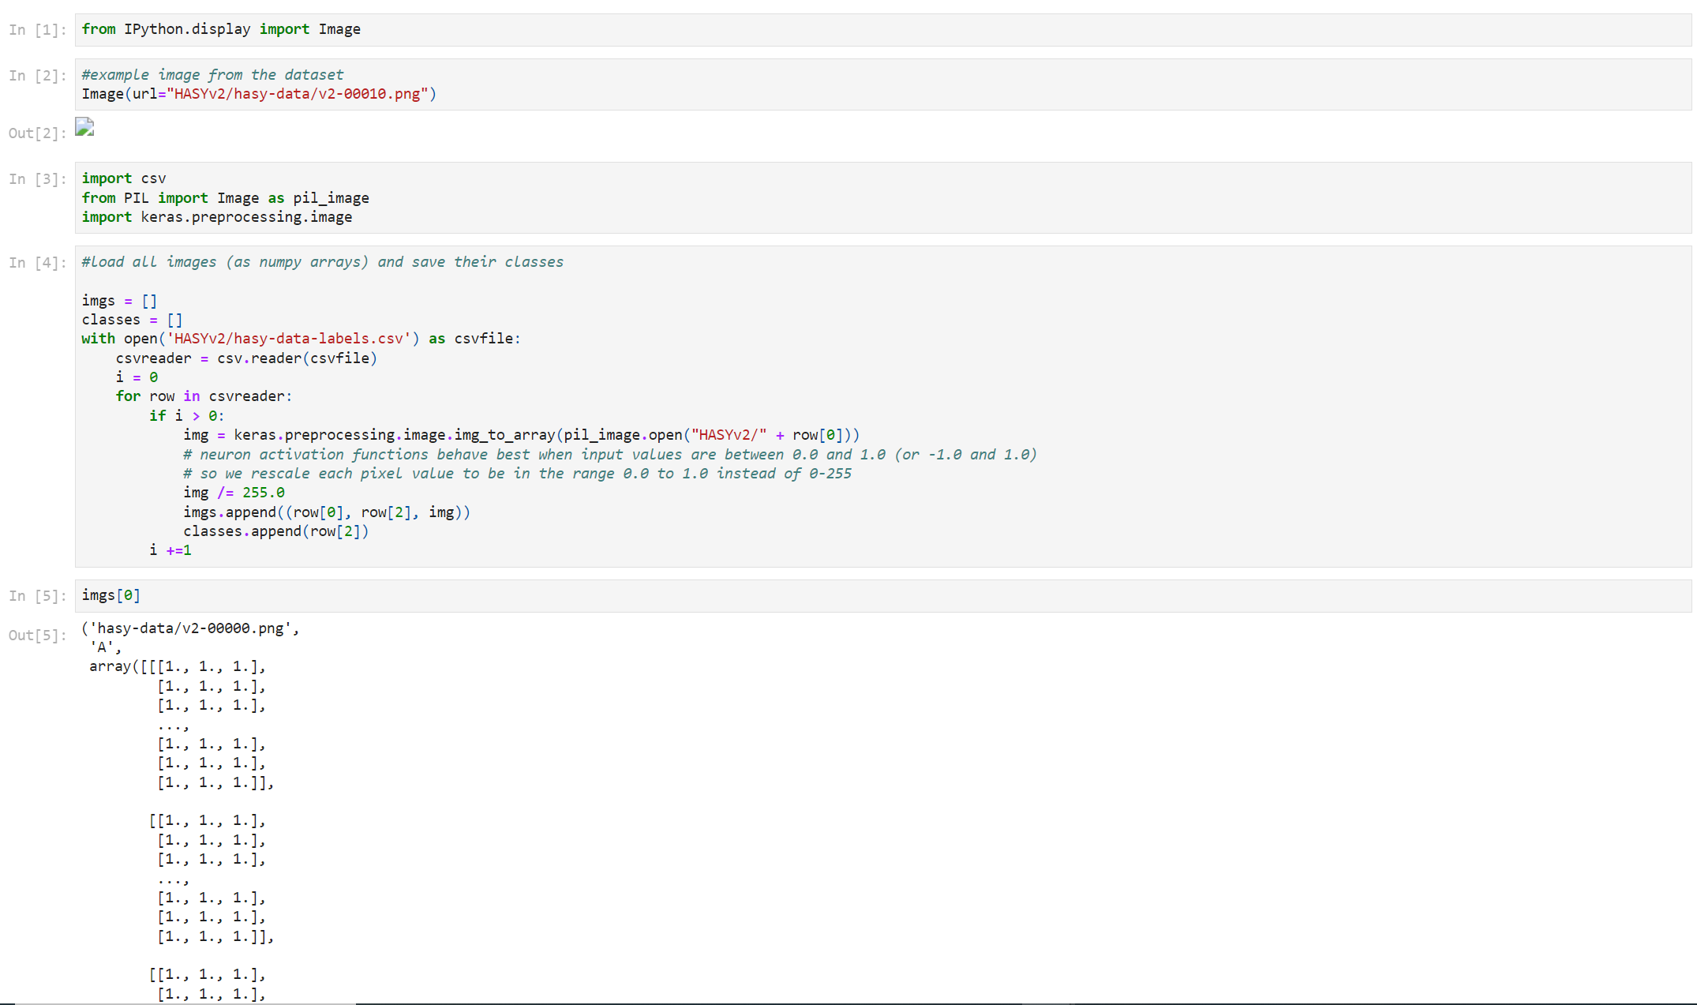
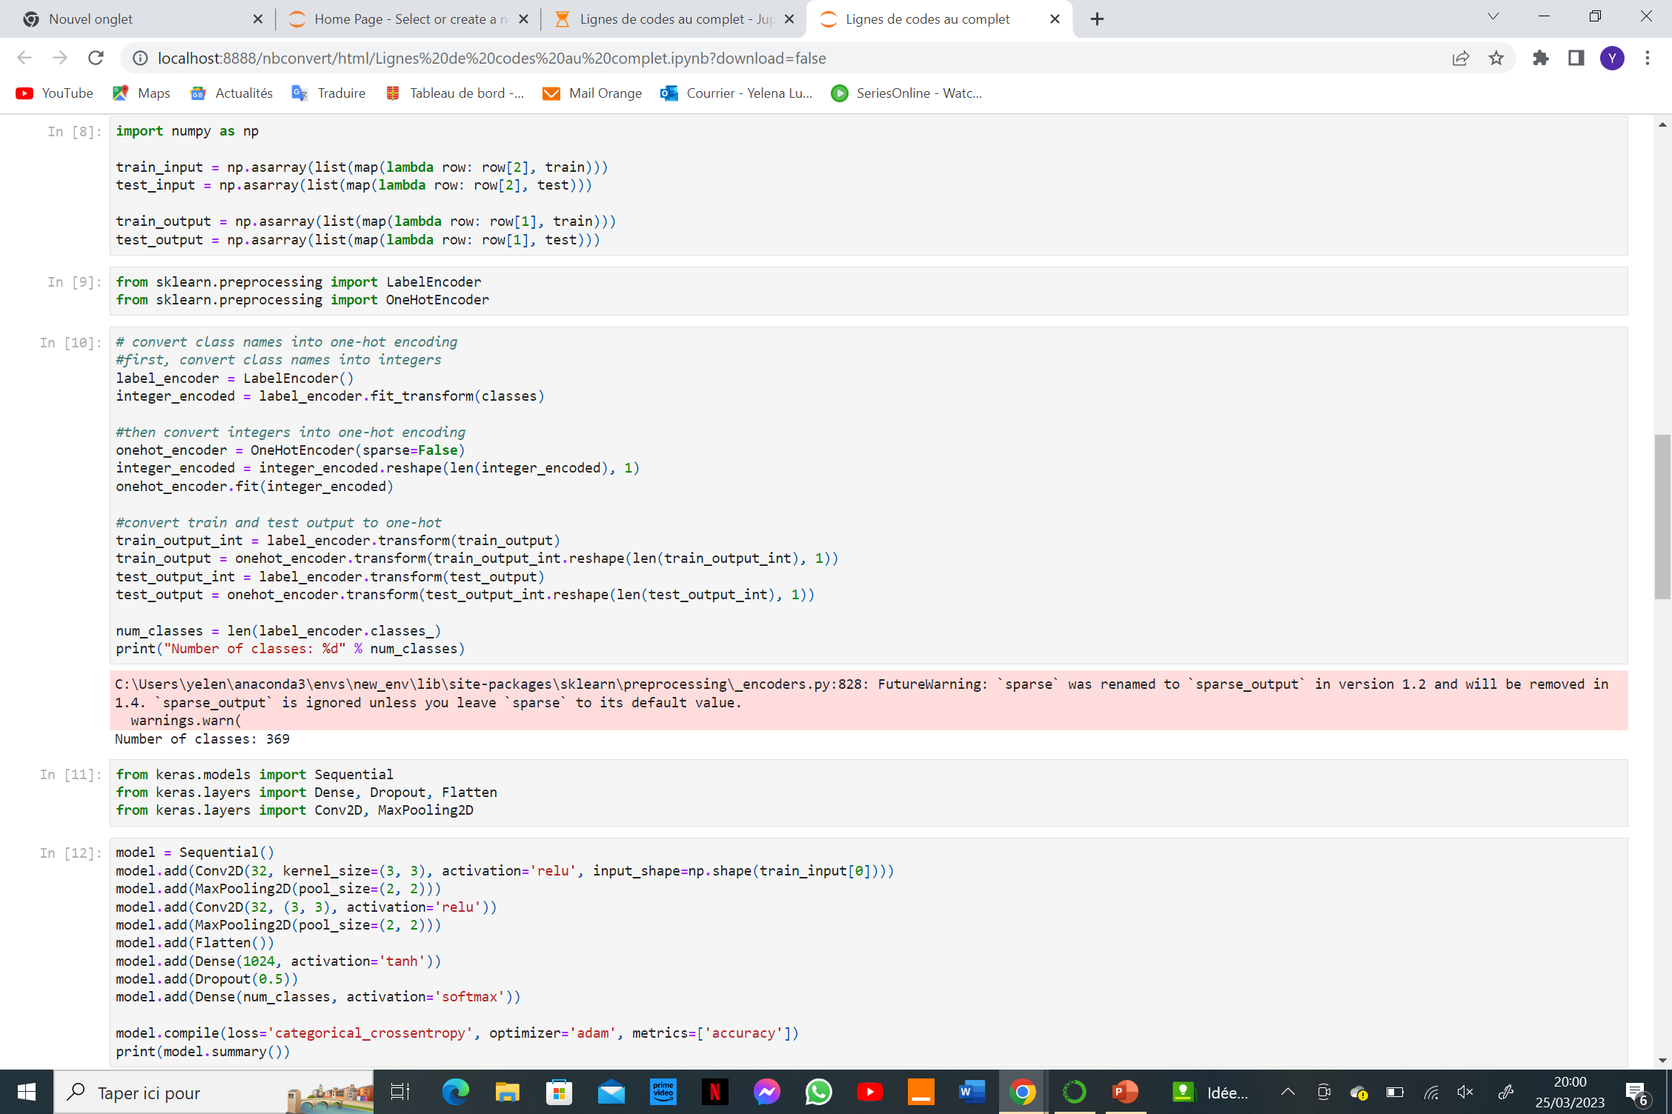
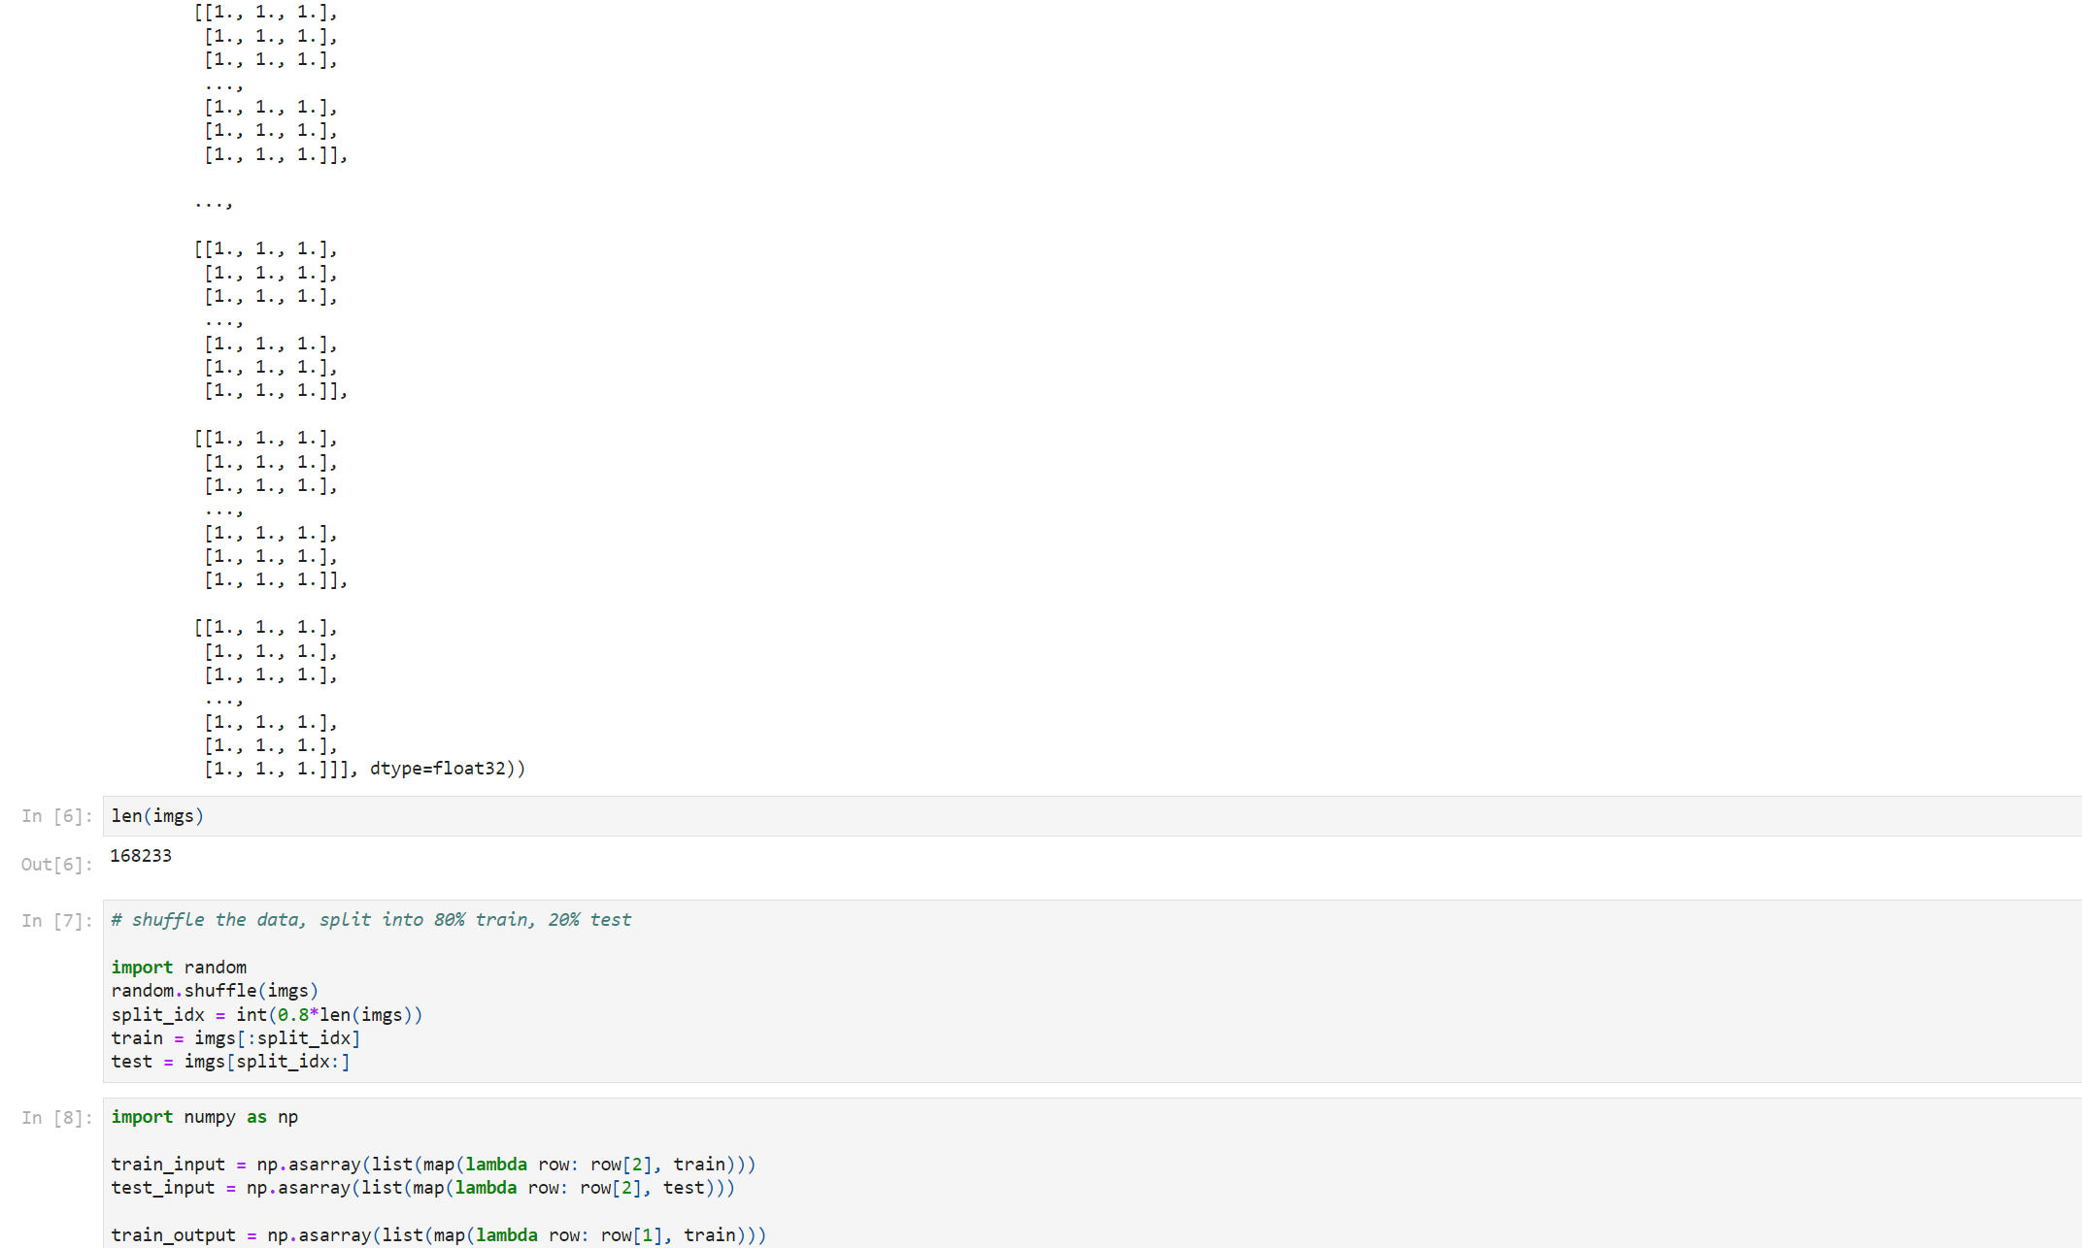
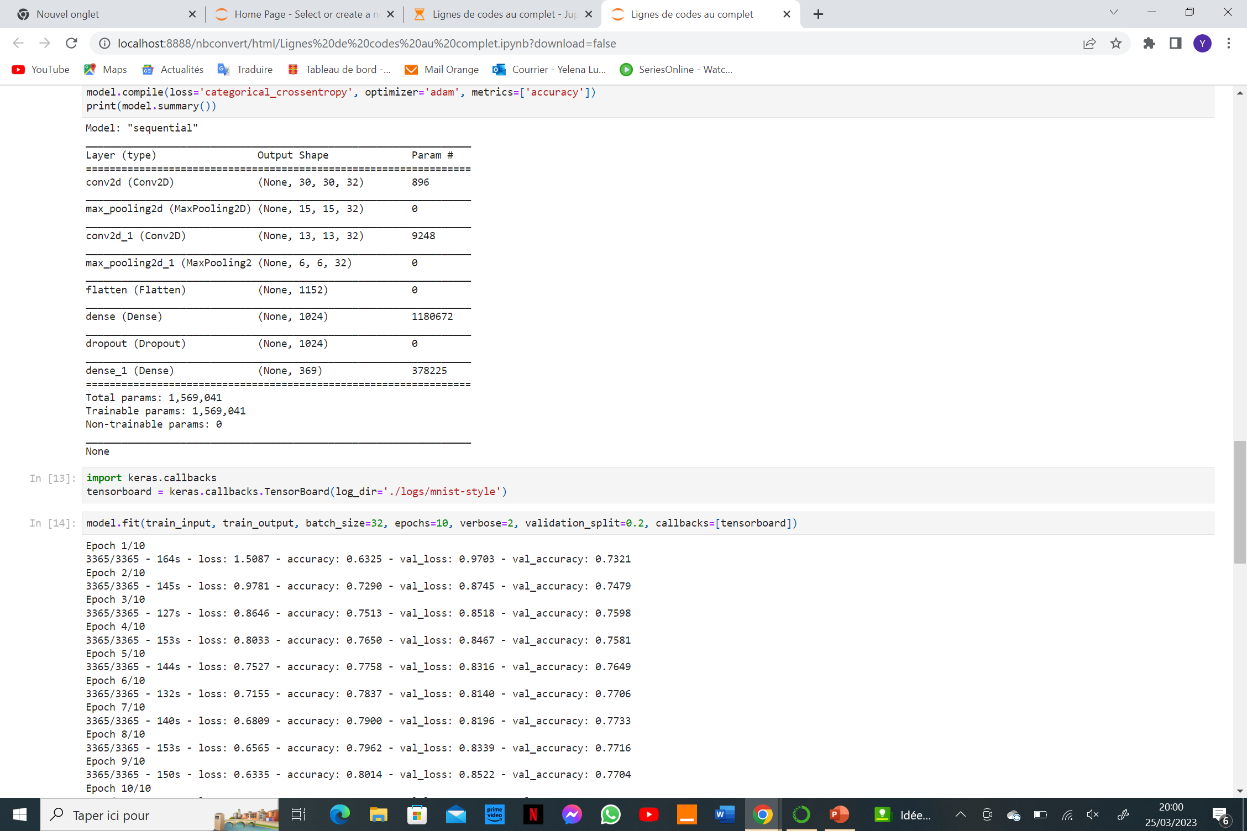
APPENDIX: SOFTWARE AND DATASETS: Case 1

Slide 13
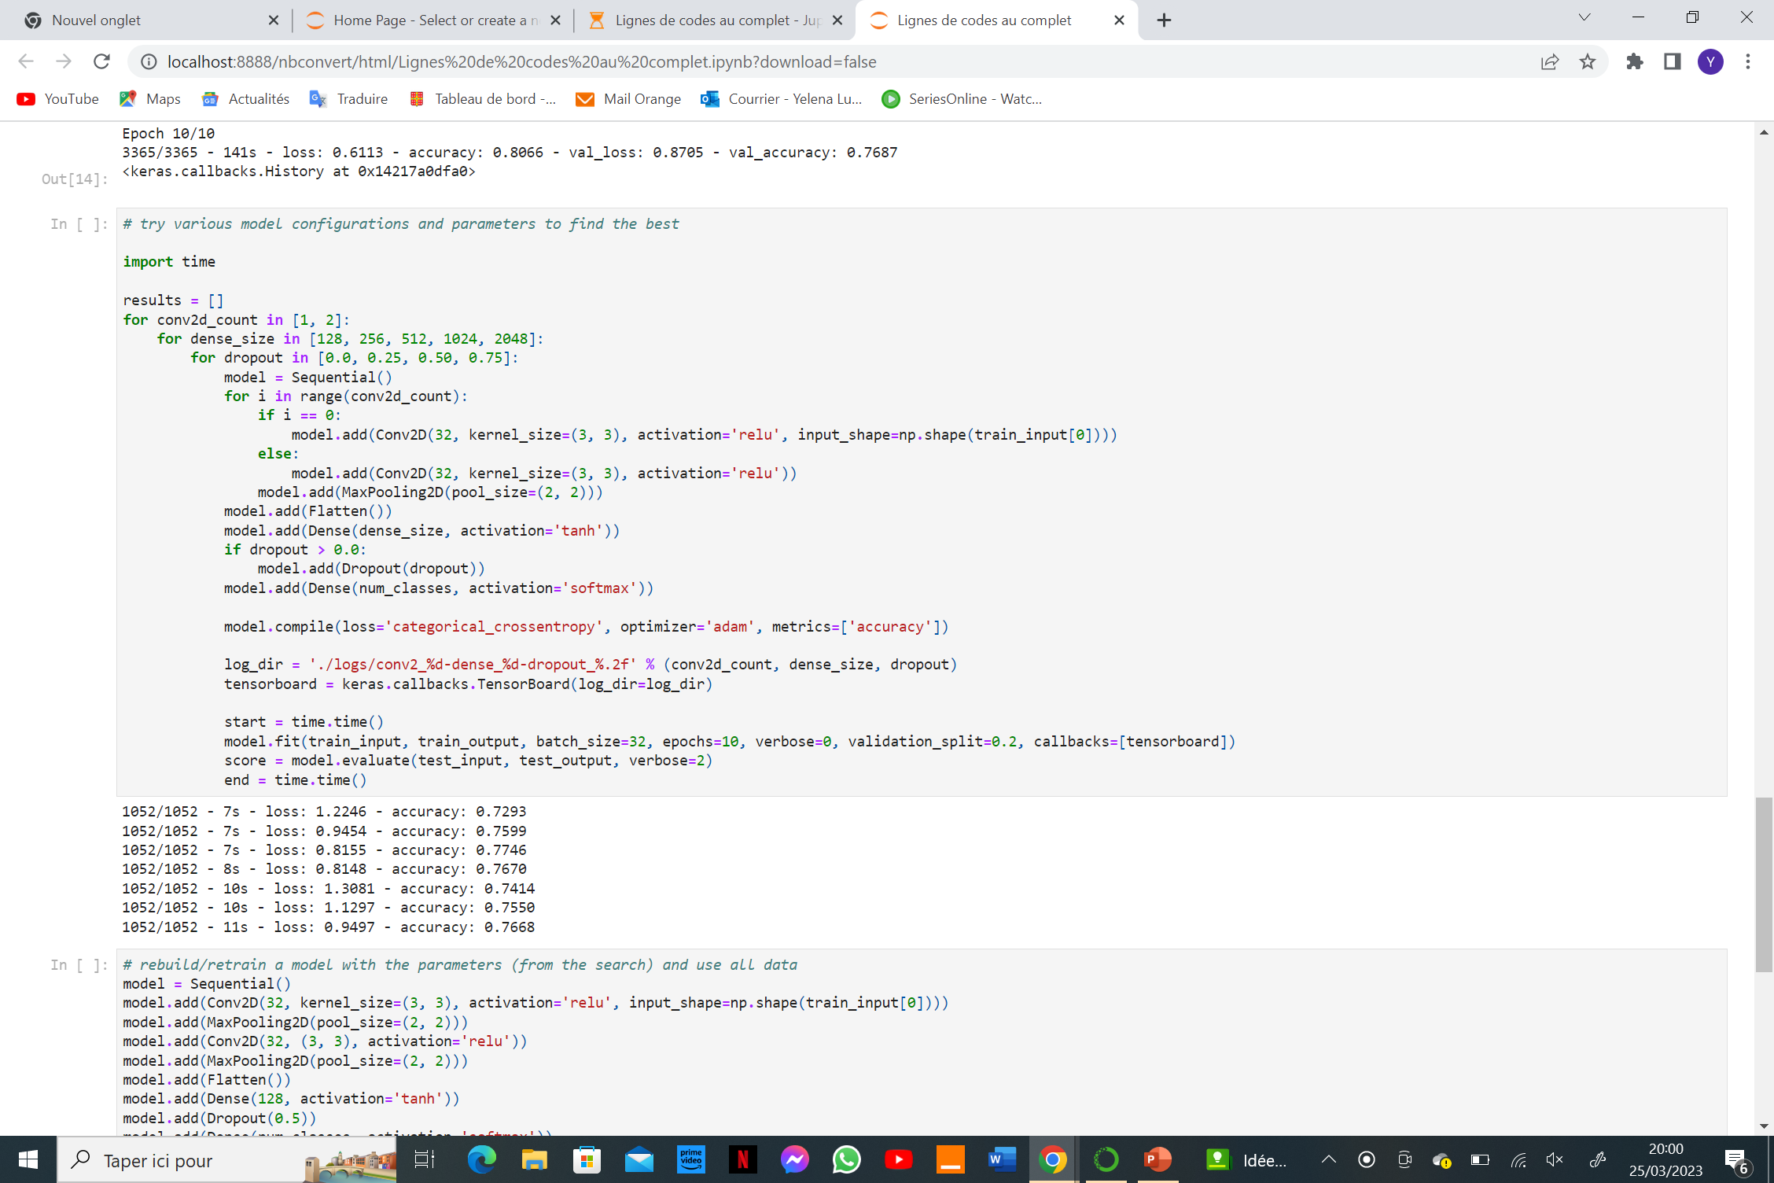
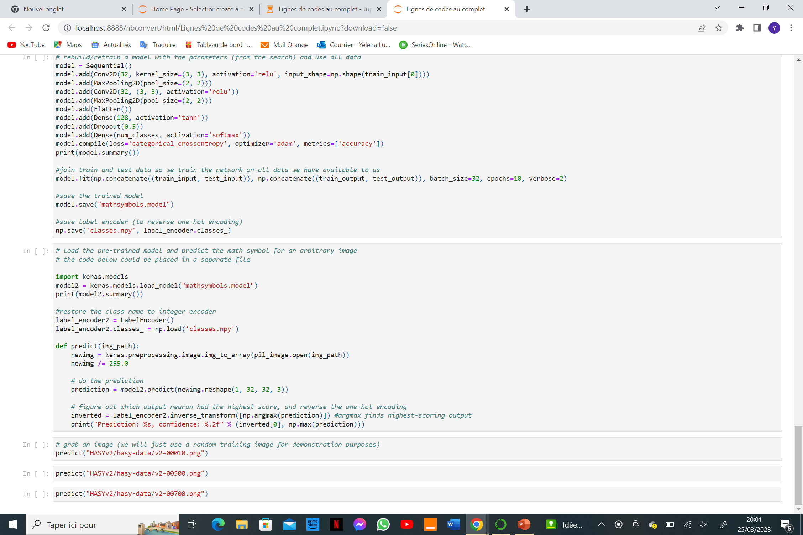
APPENDIX: SOFTWARE AND DATASETS: Case 1

Slide 14
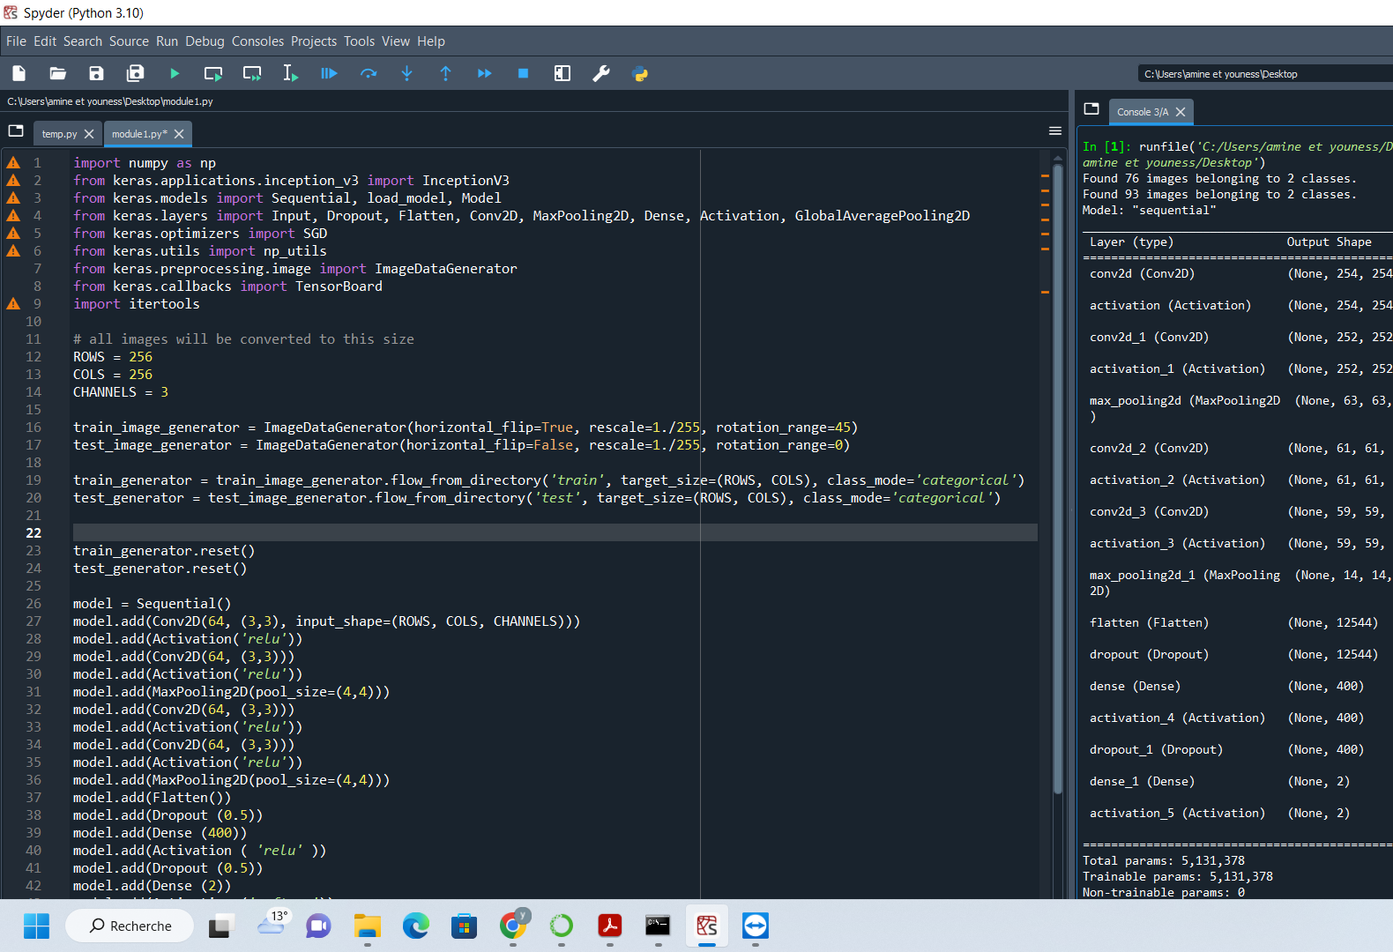
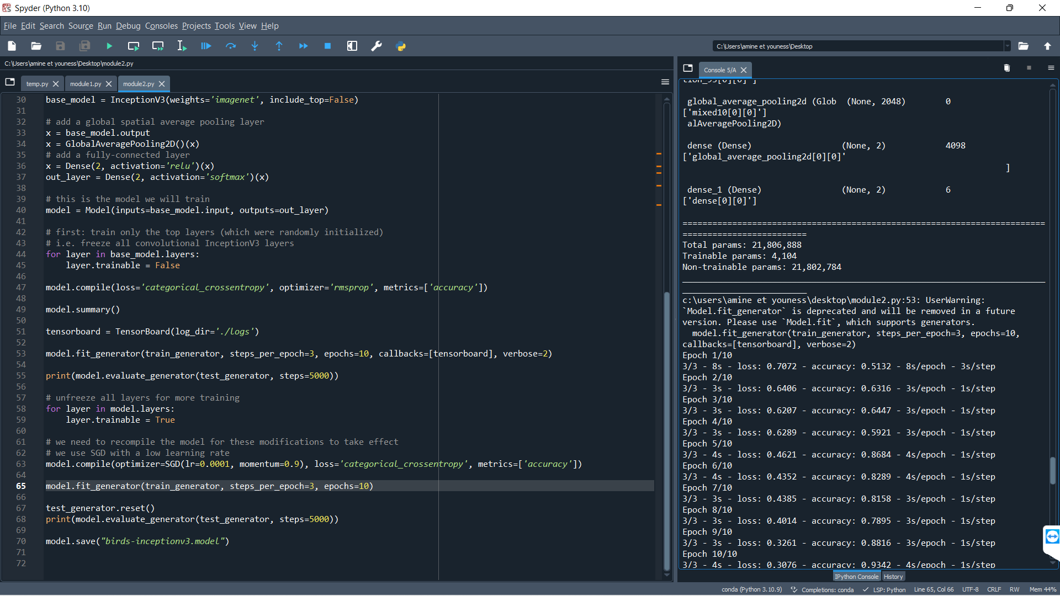
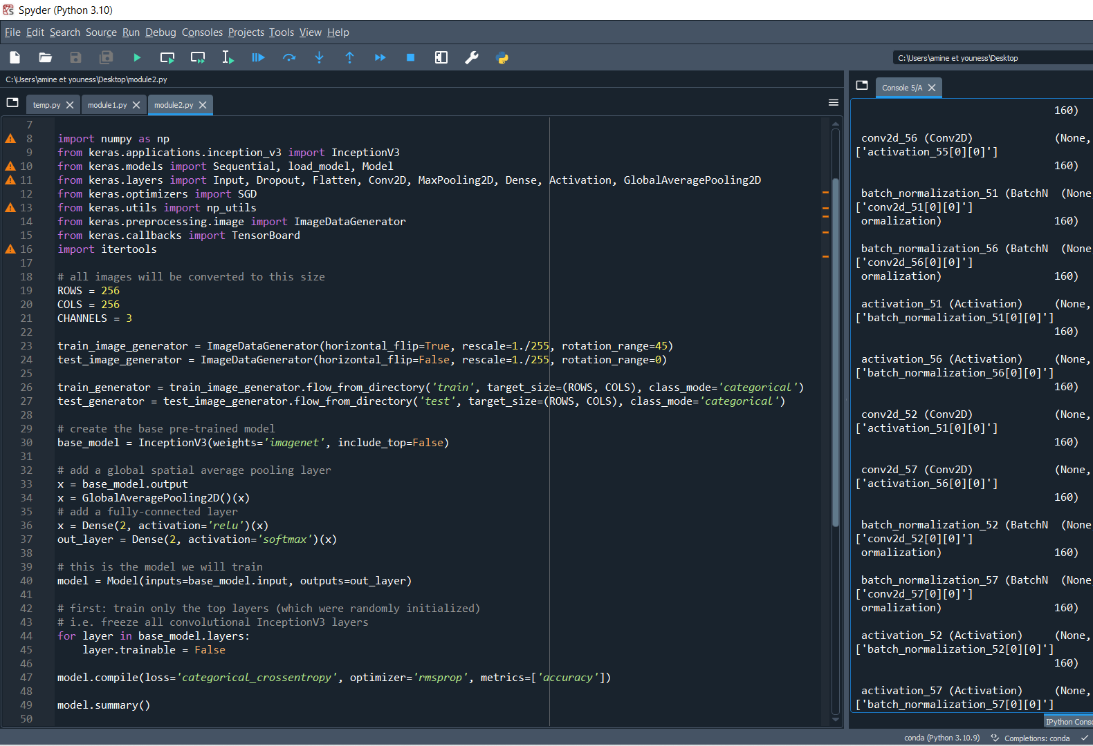
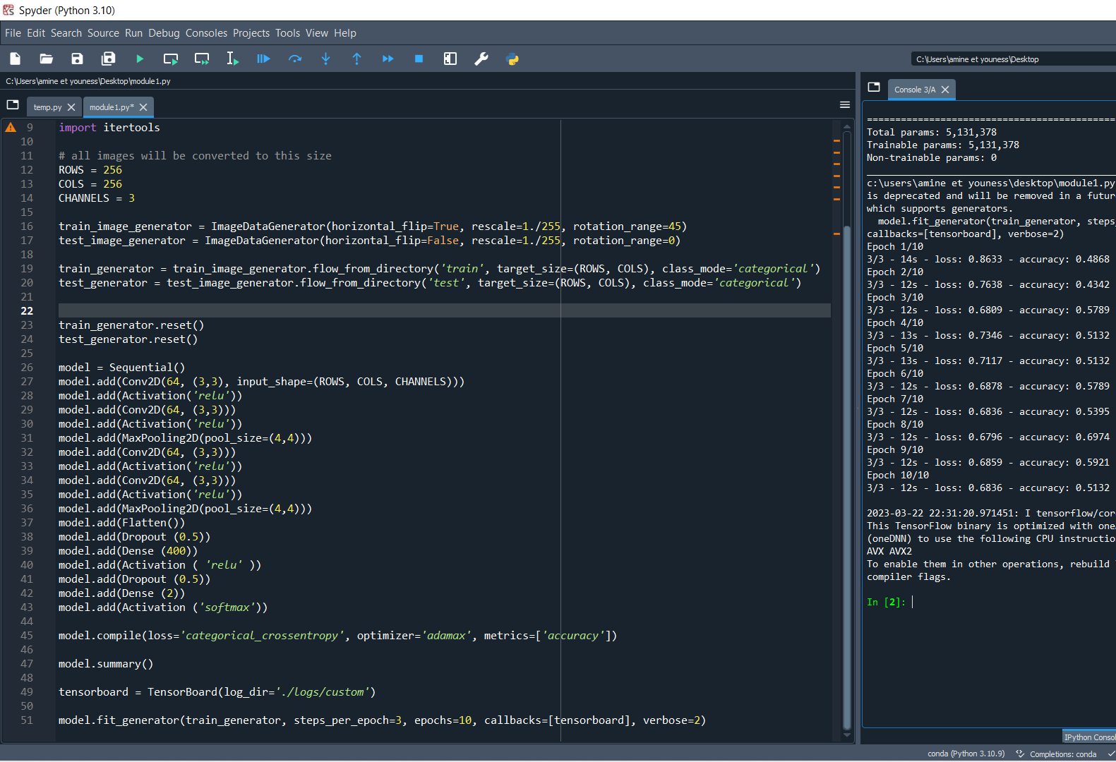
APPENDIX: SOFTWARE AND DATASETS: Case 2

